Slide 1

Starter Task
Login to a computer (might take a while)
Sign into Glow then open Teams

Slide 2
Learning intentions and success criteria
I am learning…
I can…
About Mr Wang and his lab rules
About NPA Digital Media(Level 5)
Follow Mr Wang’s rules and make him very happy ☺
Discuss my interests in digital media

Slide 3

Welcome to Digital Media
NPA Digital Media

Slide 4
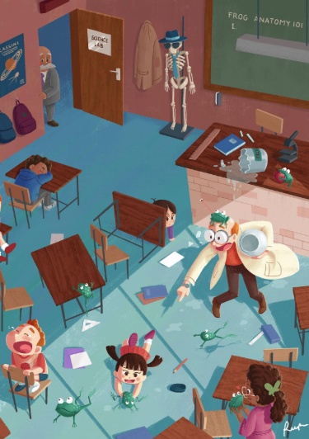
Lab Rules
OPENS Policy
No food in the lab
You can have water at central desks but not at PCs
Sit at your designated seats (seating plan)
Questions very welcome!

Slide 5
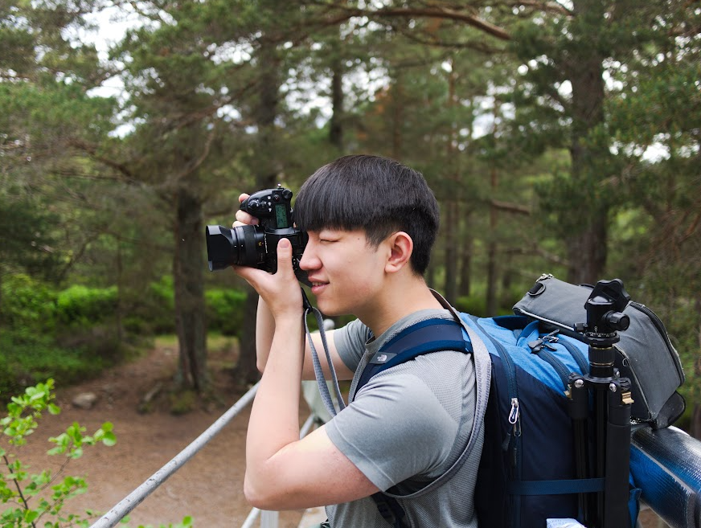
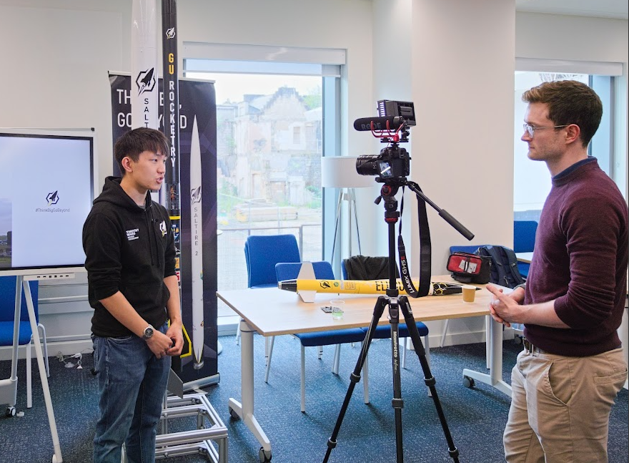
My Introduction
My name is Mr Wang!
I have done professional photo and video work in the past

Slide 6
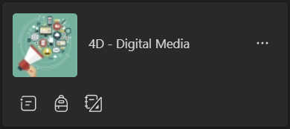
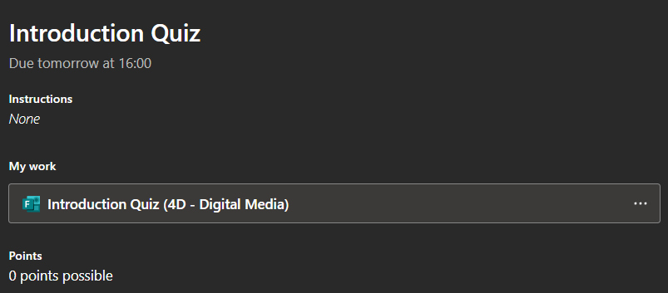
Getting to know you
Check to see if you are in the class Team
Then, complete the Introduction Quiz assignment

Slide 7
Moving to Level 5
Just like Level 4 Digital Media, you will continue developing skills in handling:
Audio - Audacity
Still images - PhotoPlus
Moving images (video) - iMovie

Slide 8
Level 5 Assessment Brief
The theme is a day in the life of a pupil, You are to acquire at least:
10 photographs, one of which should contain a person
8 audio clips
6 moving images
The media elements should cover a range of stills, audio and moving images to show what a typical day in your life is like, for example, traffic, playing games, walking or what you do at home.
This is to be presented either as a presentation, blog, website or a movie.

Slide 9
Level 5 Assessment Brief
This project will involve four tasks:
Planning
Acquisition
Editing and production
Evaluation
Throughout the project you will need to maintain a logbook of your progress.

Slide 10
Task 1: Planning
You must supply the following plans for approval before acquiring any of the media elements.
Identify still images, sounds and moving images to suit the brief
Script/Storyboard/Shot-list
Production Schedule with breakdown of timescales
Describe hardware and software required
Identify camera functions used to acquire still images
Copyright status for each media element along with remedial action (where required)

Slide 11
Task 2: Acquisition
Task 2 consists of the actual acquisition of media elements as defined in your plan in task 1. You must acquire at least:
10 digital still images and editing of at least six
8 audio clips
6 moving images
During and after acquisition you must:
Acquire all required media elements
Ensure all media elements, whether these are going to be used or not, are clearly labelled in appropriate file formats with a note of where they are stored
Keep a record of any copyright implications

Slide 12
Task 3: Editing and Production
Task 3 involves producing a media product using the portfolio of all media elements, ensuring you are adhering to the timescales in your production schedule:
Edit all required media elements
Description of editing techniques used
Create a digital media product with all the media elements
Save the media product in an appropriate compressed file format
Present the digital media product to an intended audience

Slide 13
Task 4: Evaluation
Task 4 involves you evaluating the final digital media product and your performance:
Description of what still image editing techniques were used
Evaluate the appropriateness of your chosen editing techniques
Evaluate your finished product against the requirements of the brief
Explain any solutions used to resolve issues in the production of the product
Identify any steps to improve further still image work produced

Slide 14
Learning intentions and success criteria
I am learning…
I can…
About Mr Wang and his lab rules
About NPA Computer Games Development (Level 5)
Follow Mr Wang’s rules and make him very happy ☺
Discuss my interest in game development

